Slide 1
CHAPTER 12
Analysis of Variance Tests
to accompany
Introduction to Business Statistics
seventh edition, by Ronald M. Weiers
Presentation by Priscilla Chaffe-Stengel
Donald N. Stengel
© 2011 Cengage Learning.
All Rights Reserved. May not be scanned, copied, or duplicated, or posted to a publicly accessible website, in whole or in part.

Slide 2
Chapter 12 - Learning Objectives
Describe the relationship between analysis of variance, the design of experiments, and the types of applications to which the experiments are applied.
Differentiate one-way, randomized block, and two-way analysis of variance techniques.
Arrange data into a format that facilitates their analysis by the appropriate analysis of variance technique.
Use the appropriate methods in testing hypotheses relative to the experimental data.
© 2011 Cengage Learning.
All Rights Reserved. May not be scanned, copied, or duplicated, or posted to a publicly accessible website, in whole or in part.

Slide 3
Chapter 12 - Key Terms
Factor level, treatment, block, interaction
Within-group variation
Between-group variation
Completely randomized design
Randomized block design
Two-way analysis of variance, factorial experiment
Sum of squares:
  Treatment
  Error
  Block
  Interaction
  Total
© 2011 Cengage Learning.
All Rights Reserved. May not be scanned, copied, or duplicated, or posted to a publicly accessible website, in whole or in part.

Slide 4
Chapter 12 - Key Concepts
Differences in outcomes on a dependent variable may be explained to some degree by differences in the independent variables.
Variation between treatment groups captures the effect of the treatment.
Variation within treatment groups represents random error not explained by the experimental treatments.
© 2011 Cengage Learning.
All Rights Reserved. May not be scanned, copied, or duplicated, or posted to a publicly accessible website, in whole or in part.

Slide 5
One-Way ANOVA
Purpose: Examines two or more levels of an independent variable to determine if their population means could be equal.
Hypotheses:
  H₀: µ₁ = µ₂ = ... = µ_{t} *
  H₁: At least one of the treatment group means differs from the rest. OR At least two of the population means are not equal.
  * where t = number of treatment groups or levels
© 2011 Cengage Learning.
All Rights Reserved. May not be scanned, copied, or duplicated, or posted to a publicly accessible website, in whole or in part.

Slide 6
One-Way ANOVA, cont.
Format for data: Data appear in separate columns or rows, organized by treatment groups. Sample size of each group may differ.
Calculations:
  SST = SSTR + SSE (definitions follow)
  Sum of squares total (SST) = sum of squared differences between each individual data value (regardless of group membership) minus the grand mean, , across all data... total variation in the data (not variance).
x
SST
=
∑
∑
(
x
–
x
)
2
ij
© 2011 Cengage Learning.
All Rights Reserved. May not be scanned, copied, or duplicated, or posted to a publicly accessible website, in whole or in part.

Slide 7
One-Way ANOVA, cont.
Calculations, cont.:
  Sum of squares treatment (SSTR) = sum of squared differences between each group mean and the grand mean, balanced by sample size... between-groups variation (not variance).
  Sum of squares error (SSE) = sum of squared differences between the individual data values and the mean for the group to which each belongs... within-group variation (not variance).
SSTR
=
∑
n
(
x
–
x
)
2
j
j
SSE
=
∑
∑
(
x
–
x
)
2
ij
j
© 2011 Cengage Learning.
All Rights Reserved. May not be scanned, copied, or duplicated, or posted to a publicly accessible website, in whole or in part.

Slide 8
One-Way ANOVA, cont.
Calculations, cont.:
  Mean square treatment (MSTR) = SSTR/(t – 1) where t is the number of treatment groups... between-groups variance.
  Mean square error (MSE) = SSE/(N – t) where N is the number of elements sampled and t is the number of treatment groups... within-groups variance.
  F-Ratio = MSTR/MSE, where numerator degrees of freedom are t – 1 and denominator degrees of freedom are N – t.
© 2011 Cengage Learning.
All Rights Reserved. May not be scanned, copied, or duplicated, or posted to a publicly accessible website, in whole or in part.

Slide 9
One-Way ANOVA - An Example
Problem 12.30: Safety researchers, interested in determining if occupancy of a vehicle might be related to the speed at which the vehicle is driven, have checked the following speed (MPH) measurements for two random samples of vehicles:
Driver alone: 64 50 71 55 67 61 80 56 59 74
1+ rider(s): 44 52 54 48 69 67 54 57 58 51 62 67
a. What are the null and alternative hypotheses?
H₀: µ₁ = µ₂ where Group 1 = driver alone
H₁: µ₁ ≠ µ₂ Group 2 = with rider(s)
© 2011 Cengage Learning.
All Rights Reserved. May not be scanned, copied, or duplicated, or posted to a publicly accessible website, in whole or in part.

Slide 10
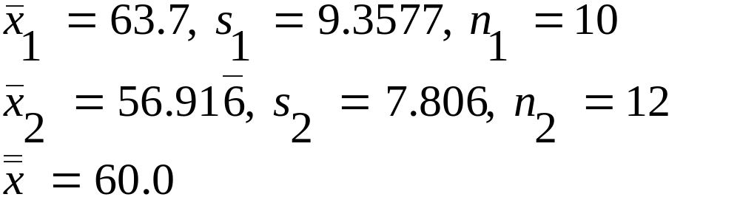
One-Way ANOVA - An Example
b. Use ANOVA and the 0.025 level of significance in testing the appropriate null hypothesis.
SSTR = 10(63.7 – 60)² + 12(56.917 – 60)² = 250.983
SSE = (64 – 63.7 )² + (50 – 63.7 )² + ... + (74 – 63.7 )²
+ (44 – 56.917) ² + (52 – 56.917) ² + ... + (67 – 56.917) ²
= 1487.017
SSTotal = (64 – 60 )² + (50 – 60 )² + ... + (74 – 60 )²
+ (44 – 60) ² + (52 – 60) ² + ... + (67 – 60) ²
= 1738
© 2011 Cengage Learning.
All Rights Reserved. May not be scanned, copied, or duplicated, or posted to a publicly accessible website, in whole or in part.

Slide 11
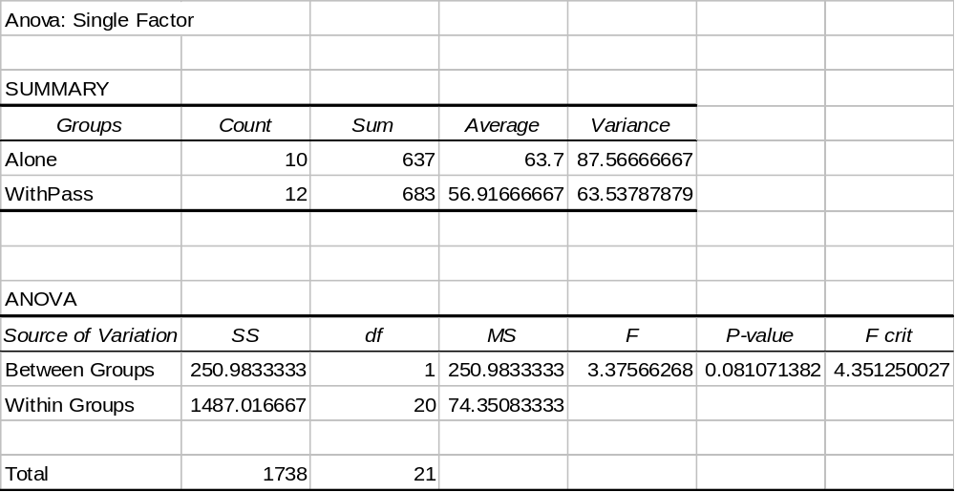
One-Way ANOVA - An Example
Compare calculated values to those in the Excel output:
The test statistic The p-value The critical bound
© 2011 Cengage Learning.
All Rights Reserved. May not be scanned, copied, or duplicated, or posted to a publicly accessible website, in whole or in part.

Slide 12
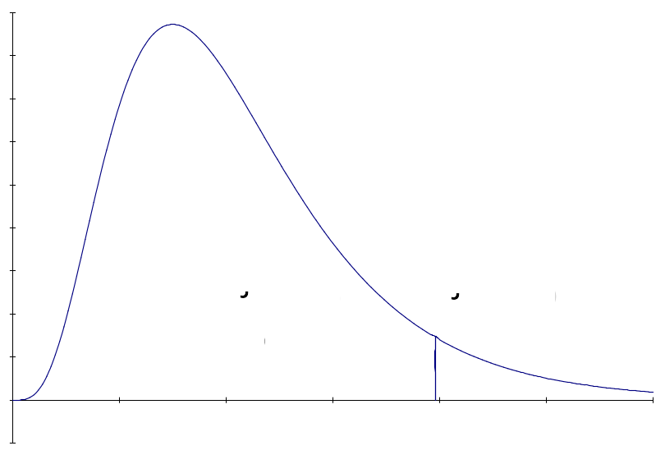
One-Way ANOVA - An Example
Source of Sum of Degrees of Mean
Variation Squares Freedom Square F-Ratio
Treatments 250.983 1 250.983 3.38
Error 1487.017 20 74.351
Total 1738. 21
I. H₀: µ₁ = µ₂ H₁: µ₁ ≠ µ₂
II. Rejection Region:
α = 0.025
df_{num} = 1 If F > 4.35, reject H₀.
df_{denom} = 20
0.95
0.05
F=4.35
© 2011 Cengage Learning.
All Rights Reserved. May not be scanned, copied, or duplicated, or posted to a publicly accessible website, in whole or in part.

Slide 13
One-Way ANOVA - An Example
III. Test Statistic: F = 250.983 / 74.351 = 3.38
IV. Conclusion: Since the test statistic of F = 3.38 falls below the critical value of F = 4.35, we do not reject H₀ with at most 2.5% error.
V. Implications: There is not enough evidence to conclude that the speed at which a vehicle is driven changes depending on whether the driver is alone or has at least one passenger.
p-value:
To calculate the p-value, in a cell within a Microsoft Excel spreadsheet, type: =FDIST(3.38,1,20)
The answer is: p-value = 0.0809
© 2011 Cengage Learning.
All Rights Reserved. May not be scanned, copied, or duplicated, or posted to a publicly accessible website, in whole or in part.

Slide 14
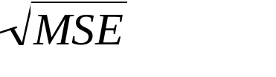
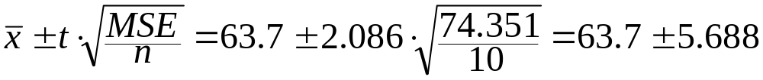
One-Way ANOVA - An Example
c. For each sample, construct the 95% confidence interval for the population mean.
Assuming each population is approximately normally distributed, we will use s = for the t confidence interval. Since MSE has 20 degrees of freedom, we will use the t for df = 20, or t = 2.086.
Sample for Driver Alone:
Lower bound = 58.012, Upper bound = 69.388
Sample for One or More Riders:
Lower bound = 51.725, Upper bound = 62.109
© 2011 Cengage Learning.
All Rights Reserved. May not be scanned, copied, or duplicated, or posted to a publicly accessible website, in whole or in part.

Slide 15
Randomized Block Design, or
One-Way ANOVA with Block
Purpose: Reduces variance within treatment groups by removing known fluctuation among different levels of a second dimension, called a “block.”
Two Sets of Hypotheses:
  Treatment Effect:
  H₀: µ₁ = µ₂ = ... = µ_{t} for treatment groups 1 through t
  H₁: At least one treatment mean differs from the rest.
  Block Effect:
  H₀: µ₁ = µ₂ = ... = µ_{n} for block groups 1 through n
  H₁: At least one block mean differs from the rest.
© 2011 Cengage Learning.
All Rights Reserved. May not be scanned, copied, or duplicated, or posted to a publicly accessible website, in whole or in part.

Slide 16

One-Way ANOVA with Block
Format for data: Data appear in a table, where location in a specific row and a specific column is important.
Calculations:
Variations - Sum of Squares:
  SST = SSTR + SSB + SSE
  Sum of squares total (SST) = sum of squared differences between each individual data value (regardless of group membership) minus the grand mean, , across all data... total variation in the data (not variance).
SST
=
∑
∑
(
x
–
x
)
2
ij
© 2011 Cengage Learning.
All Rights Reserved. May not be scanned, copied, or duplicated, or posted to a publicly accessible website, in whole or in part.

Slide 17
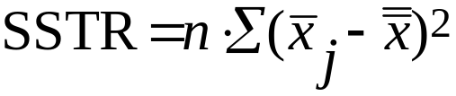

One-Way ANOVA with Block
Calculations, cont.:
  Sum of squares treatment (SSTR) = sum of squared differences between each treatment group mean and the grand mean, balanced by sample size... between-treatment-groups variation (not variance).
  Sum of squares block (SSB) = sum of squared differences between each block group mean and the grand mean, balanced by sample size... between-block-groups variation (not variance).
© 2011 Cengage Learning.
All Rights Reserved. May not be scanned, copied, or duplicated, or posted to a publicly accessible website, in whole or in part.

Slide 18
One-Way ANOVA with Block
Calculations, cont.:
  Sum of squares error (SSE):
  SSE = SST – SSTR – SSB
  Variances - Mean Squares:
  Mean square treatment (MSTR) = SSTR/(t – 1) where t is the number of treatment groups... between-treatment-groups variance.
  Mean square block (MSB) = SSB/(n – 1) where n is the number of block groups... between-block-groups variance. Controls the size of SSE by removing variation that is explained by the blocking categories.
© 2011 Cengage Learning.
All Rights Reserved. May not be scanned, copied, or duplicated, or posted to a publicly accessible website, in whole or in part.

Slide 19

One-Way ANOVA with Block
Calculations, cont.:
  Mean square error:
  where t is the number of treatment groups and n is the number of block groups... within-groups variance unexplained by either the treatment or the block group.
  Test Statistics, F-Ratios:
  F-Ratio, Treatment = MSTR/MSE, where numerator degrees of freedom are t – 1 and denominator degrees of freedom are (t – 1)(n – 1) . This F-ratio is the test statistic for the hypothesis that the treatment group means are equal. To reject the null hypothesis means that at least one treatment group had a different effect than the rest.
© 2011 Cengage Learning.
All Rights Reserved. May not be scanned, copied, or duplicated, or posted to a publicly accessible website, in whole or in part.

Slide 20
One-Way ANOVA with Block
Calculations -
Test Statistics, F-Ratios, cont.:
  F-Ratio, Block = MSB/MSE, where numerator degrees of freedom are n – 1 and denominator degrees of freedom are (t – 1)(n – 1). This F-ratio is the test statistic for the hypothesis that the block group means are equal. To reject the null hypothesis means that at least one block group had a different effect on the dependent variable than the rest.
© 2011 Cengage Learning.
All Rights Reserved. May not be scanned, copied, or duplicated, or posted to a publicly accessible website, in whole or in part.

Slide 21
Two-Way ANOVA
Purpose: Examines (1) the effect of Factor A on the dependent variable, y; (2) the effect of Factor B on the dependent variable, y; along with (3) the effects of the interactions between different levels of the two factors on the dependent variable , y.
© 2011 Cengage Learning.
All Rights Reserved. May not be scanned, copied, or duplicated, or posted to a publicly accessible website, in whole or in part.

Slide 22
Two-Way ANOVA
Three Sets of Hypotheses:
  Factor A Effect:
  H₀: µ₁ = µ₂ = ... = µ_{a} for treatment groups 1 through a
  H₁: At least one Factor A level mean differs from the rest.
  Factor B Effect:
  H₀: µ₁ = µ₂ = ... = µ_{b} for block groups 1 through b
  H₁: At least one Factor B level mean differs from the rest.
  Interaction Effect:
  H₀: There are no interaction effects.
  H₁: At least one combination of Factor A and Factor B levels has an effect on the dependent variable.
© 2011 Cengage Learning.
All Rights Reserved. May not be scanned, copied, or duplicated, or posted to a publicly accessible website, in whole or in part.

Slide 23
Two-Way ANOVA
Format for data: Data appear in a grid, each cell having two or more entries. The number of values in each cell is constant across the grid and represents r, the number of replications within each cell.
Calculations: Variations - Sum of Squares
  SST = SSA + SSB + SSAB + SSE
  Sum of squares total (SST) = sum of squared differences between each individual data value (regardless of group membership) minus the grand mean, , across all data... total variation in the data (not variance).
SST
=
∑
∑
∑
(
x
–
x
)
2
© 2011 Cengage Learning.
All Rights Reserved. May not be scanned, copied, or duplicated, or posted to a publicly accessible website, in whole or in part.

Slide 24
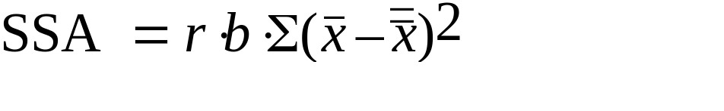
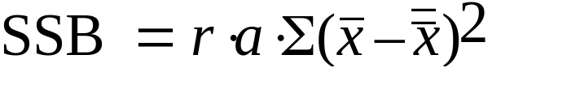
Two-Way ANOVA
Calculations, cont.:
  Sum of squares Factor A (SSA) = sum of squared differences between each group mean for Factor A and the grand mean, balanced by sample size... between-factor-groups variation (not variance).
  Sum of squares Factor B (SSB) = sum of squared differences between each group mean for Factor B and the grand mean, balanced by sample size... between-factor-groups variation (not variance).
© 2011 Cengage Learning.
All Rights Reserved. May not be scanned, copied, or duplicated, or posted to a publicly accessible website, in whole or in part.

Slide 25
Two-Way ANOVA
Calculations, cont.:
  Sum of squares Error (SSE) = sum of squared differences between individual values and their cell mean... within-groups variation (not variance).
  Sum of squares Interaction:
  SSAB = SST – SSA – SSB – SSE
SSE
=
∑
∑
∑
(
x
–
x
)
2
ij
© 2011 Cengage Learning.
All Rights Reserved. May not be scanned, copied, or duplicated, or posted to a publicly accessible website, in whole or in part.

Slide 26
Two-Way ANOVA
Calculations: Variances - Mean Squares
  Mean Square Factor A (MSA) = SSA/(a – 1), where a = the number of levels of Factor A ... between-levels variance, Factor A.
  Mean Square Factor B (MSB) = SSB/(b – 1), where b = the number of levels of Factor B ... between-levels variance, Factor B.
© 2011 Cengage Learning.
All Rights Reserved. May not be scanned, copied, or duplicated, or posted to a publicly accessible website, in whole or in part.

Slide 27
Two-Way ANOVA
Calculations - Variances, cont.:
  Mean Square Interaction (MSAB) = SSAB/(a – 1)(b – 1). Controls the size of SSE by removing fluctuation due to the combined effect of Factor A and Factor B.
  Mean Square Error (MSE) = SSE/ab(r – 1), where ab(r – 1) = the degrees of freedom on error ... the within-groups variance.
© 2011 Cengage Learning.
All Rights Reserved. May not be scanned, copied, or duplicated, or posted to a publicly accessible website, in whole or in part.

Slide 28
Two-Way ANOVA
Calculations - F-Ratios:
  F-Ratio, Factor A = MSA/MSE, where numerator degrees of freedom are a – 1 and denominator degrees of freedom are ab(r – 1). This F-ratio is the test statistic for the hypothesis that the Factor A group means are equal. To reject the null hypothesis means that at least one Factor A group had a different effect on the dependent variable than the rest.
© 2011 Cengage Learning.
All Rights Reserved. May not be scanned, copied, or duplicated, or posted to a publicly accessible website, in whole or in part.

Slide 29
Two-Way ANOVA
Calculations - F-Ratios:
  F-Ratio, Factor B = MSB/MSE, where numerator degrees of freedom are b – 1 and denominator degrees of freedom are ab(r – 1). This F-ratio is the test statistic for the hypothesis that the Factor B group means are equal. To reject the null hypothesis means that at least one Factor B group had a different effect on the dependent variable than the rest.
© 2011 Cengage Learning.
All Rights Reserved. May not be scanned, copied, or duplicated, or posted to a publicly accessible website, in whole or in part.

Slide 30
Two-Way ANOVA
Calculations - F-Ratios:
  F-Ratio, Interaction = MSAB/MSE, where numerator degrees of freedom are (a – 1)( b – 1) and denominator degrees of freedom are ab(r – 1). This F-ratio is the test statistic for the hypothesis that Factors A and B operate independently. To reject the null hypothesis means that there is some relationship where levels of Factor A operate differently with different levels of Factor B.
© 2011 Cengage Learning.
All Rights Reserved. May not be scanned, copied, or duplicated, or posted to a publicly accessible website, in whole or in part.

Slide 31
Two-Way ANOVA - An Example
Problem 12.99: A magazine publisher is studying the influence of type style and darkness on the readability of her publication. Each of 12 persons has been randomly assigned to one of the cells in the experiment, and the data are the number of seconds each person requires to read a brief test item. For these data, use the 0.05 level of significance in drawing conclusions about the main and interactive effects in the experiment.
© 2011 Cengage Learning.
All Rights Reserved. May not be scanned, copied, or duplicated, or posted to a publicly accessible website, in whole or in part.

Slide 32
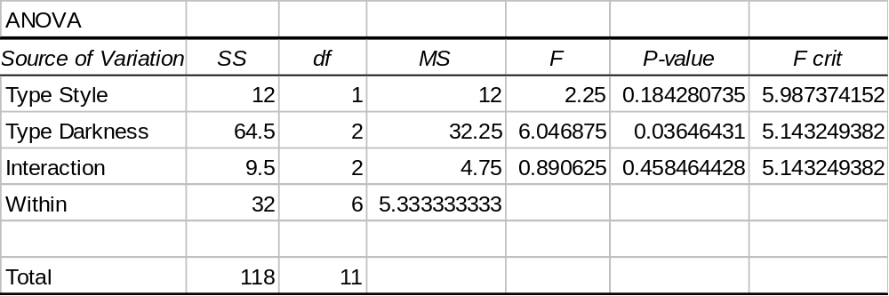
Two-Way ANOVA - An Example
Conclusions:
The two type styles do not differ in average reading time required.
F_{calc} = 2.25 < F_{crit} = 5.987, p-value = 0.18 > α = 0.05
The three type darkness levels do differ in average reading time required.
F_{calc} = 6.047 > F_{crit} = 5.143, p-value = 0.036 < α = 0.05
Type style and darkness level do not interact on average reading time required.
F_{calc} = 0.89 < F_{crit} = 5.143, p-value = 0.458 > α = 0.05
© 2011 Cengage Learning.
All Rights Reserved. May not be scanned, copied, or duplicated, or posted to a publicly accessible website, in whole or in part.

